Slide 1
Block-Structured Process Discovery: Filtering Infrequent Behaviour
Sander Leemans
Dirk Fahland
Wil van der Aalst
Eindhoven University of Technology

Slide 2
Process discovery
Fast
Fitting
Precise
General
Simple
Sound

Slide 3
Trade-off
not fitting
not sound
not simple
not sound
b
a
c
Flower model
not precise
α
ILP
τ
τ
Heuristics Miner
Evolutionary Tree Miner
f
d
e
not fitting
not sound
not fast
Notes:
Fitting, precise, simple, fast.

Slide 4
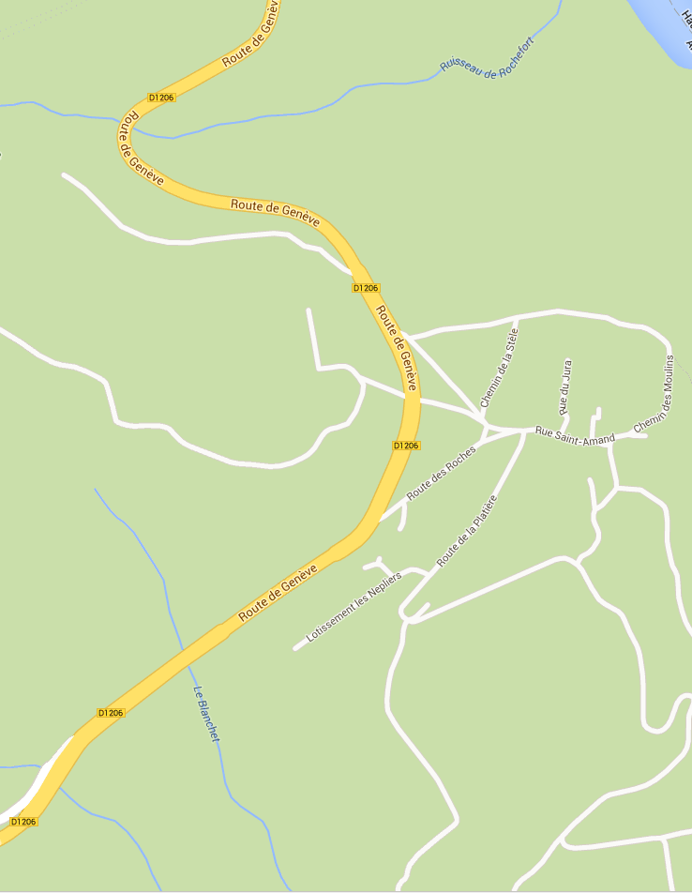
Infrequent behaviour
80% model
Filtering beforehand is difficult
Filter during discovery
Notes:
Cannot get it -> infrequent behaviour
Want to get rid of IB that screws up model
What is infrequent behaviour? -> cannot filter on forehand
Here: we filter during discovery, remove IB when detected -> go for frequent behaviour instead of all
fast

Slide 5
Outline
?

Slide 6
Process trees
a
τ
τ
b
τ
c
d
τ
x
e
/\
a
b
→
e
c
d
Notes:
Activities
Sequence
Loop
Parallel
Exclusive choice
Sound

Slide 7
Outline
?

Slide 8
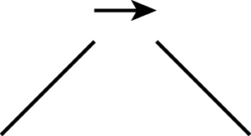
Divide & conquer
{<a,c,d,e,b>,
<a,b,e,d,c>,
<a,e,c,b,d>,
<a,d,b,c,e>}
a
{<a>,
<a>,
<a>,
<a>}
{<c,d,e,b>,
<b,e,d,c>,
<e,c,b,d>,
<d,b,c,e>}
recurse
recurse

Slide 9
Finding operator
a
{<a,c,d,e,b>,
<a,b,e,d,c>,
<a,e,c,b,d>,
<a,d,b,c,e>}
a
{<c,d,e,b>,
<b,e,d,c>,
<e,c,b,d>,
<d,b,c,e>}
b
c
d
e
Find cut in directly-follows graph
Sequence: edges crossing one-way only
recurse

Slide 10
Inductive Miner
Divide activities, select operator
Split log
Recurse until base case
?
{a,b}
{c,d}
?
{c}
{d}

Slide 11
Outline
?

Slide 12
Inductive Miner - infrequent
Divide activities, select operator
Split log
Recurse until base case
?
{a,b}
{c,d}
?
Threshold
{c}
{d}
Notes:
Local filtering

Slide 13
Divide activities, select operator
Filter infrequent edges
(b,c) 100
(b,d) 100
(b,e) 100
(b,a) 1
a
1
100
100
b
100
c
100
100
100
100
100
100
d
e
100

Slide 14
Divide activities, select operator
Weaker log
Use eventually-follows relation instead
Amplifies “correct” edges
(b,c) 1
(b,d) 1
(b,e) 1
(b,a) 1
a
1
5
1
1
4
1
b
2
c
1
1
5
5
<a, b, c>
1
2
1
1
2
a
b
c
2
1
2
d
e
1
2

Slide 15
Split log
{a}
{b}
<a,a,a,b,b,b>
<a,a,a>
<b,b,b>
<a,a>
<b,b,b>
<a,a,b,b,a,b>
<a,a,a>
<b>
Notes:
Similar trade-off holds for base cases.

Slide 16
Outline
?

Slide 17
Comparison
12 logs, 5 miners
Discover (< 2 hours)
(Convert to Petri net)
Measure
Inductive Miner
Inductive Miner - infrequent
Heuristics Miner
Integer Linear Programming Miner
Evolutionary Tree Miner
(Flower model)
(Trace model)

Slide 18
Comparison

Slide 19
Comparison

Slide 20
Comparison

Slide 21
Comparison

Slide 22
Comparison

Slide 23
Comparison
Notes:
Thanks to the structure, there is room for trade-off.

Slide 24
You have been watching In order of appearance
?
?

Slide 25
Base cases
Enough empty traces: filter
Average number of events per trace close enough to 1
< >¹⁰⁰⁰
x
<a>¹⁰⁰⁰
<a,a>¹
τ
<a>¹⁰⁰⁰
<a,a>¹
< >¹
<a>¹⁰⁰⁰
a
<a,a>¹
< >¹⁰⁰⁰
<a>¹⁰⁰⁰
<a,a>¹⁰⁰⁰
a
τ

